Slide 1
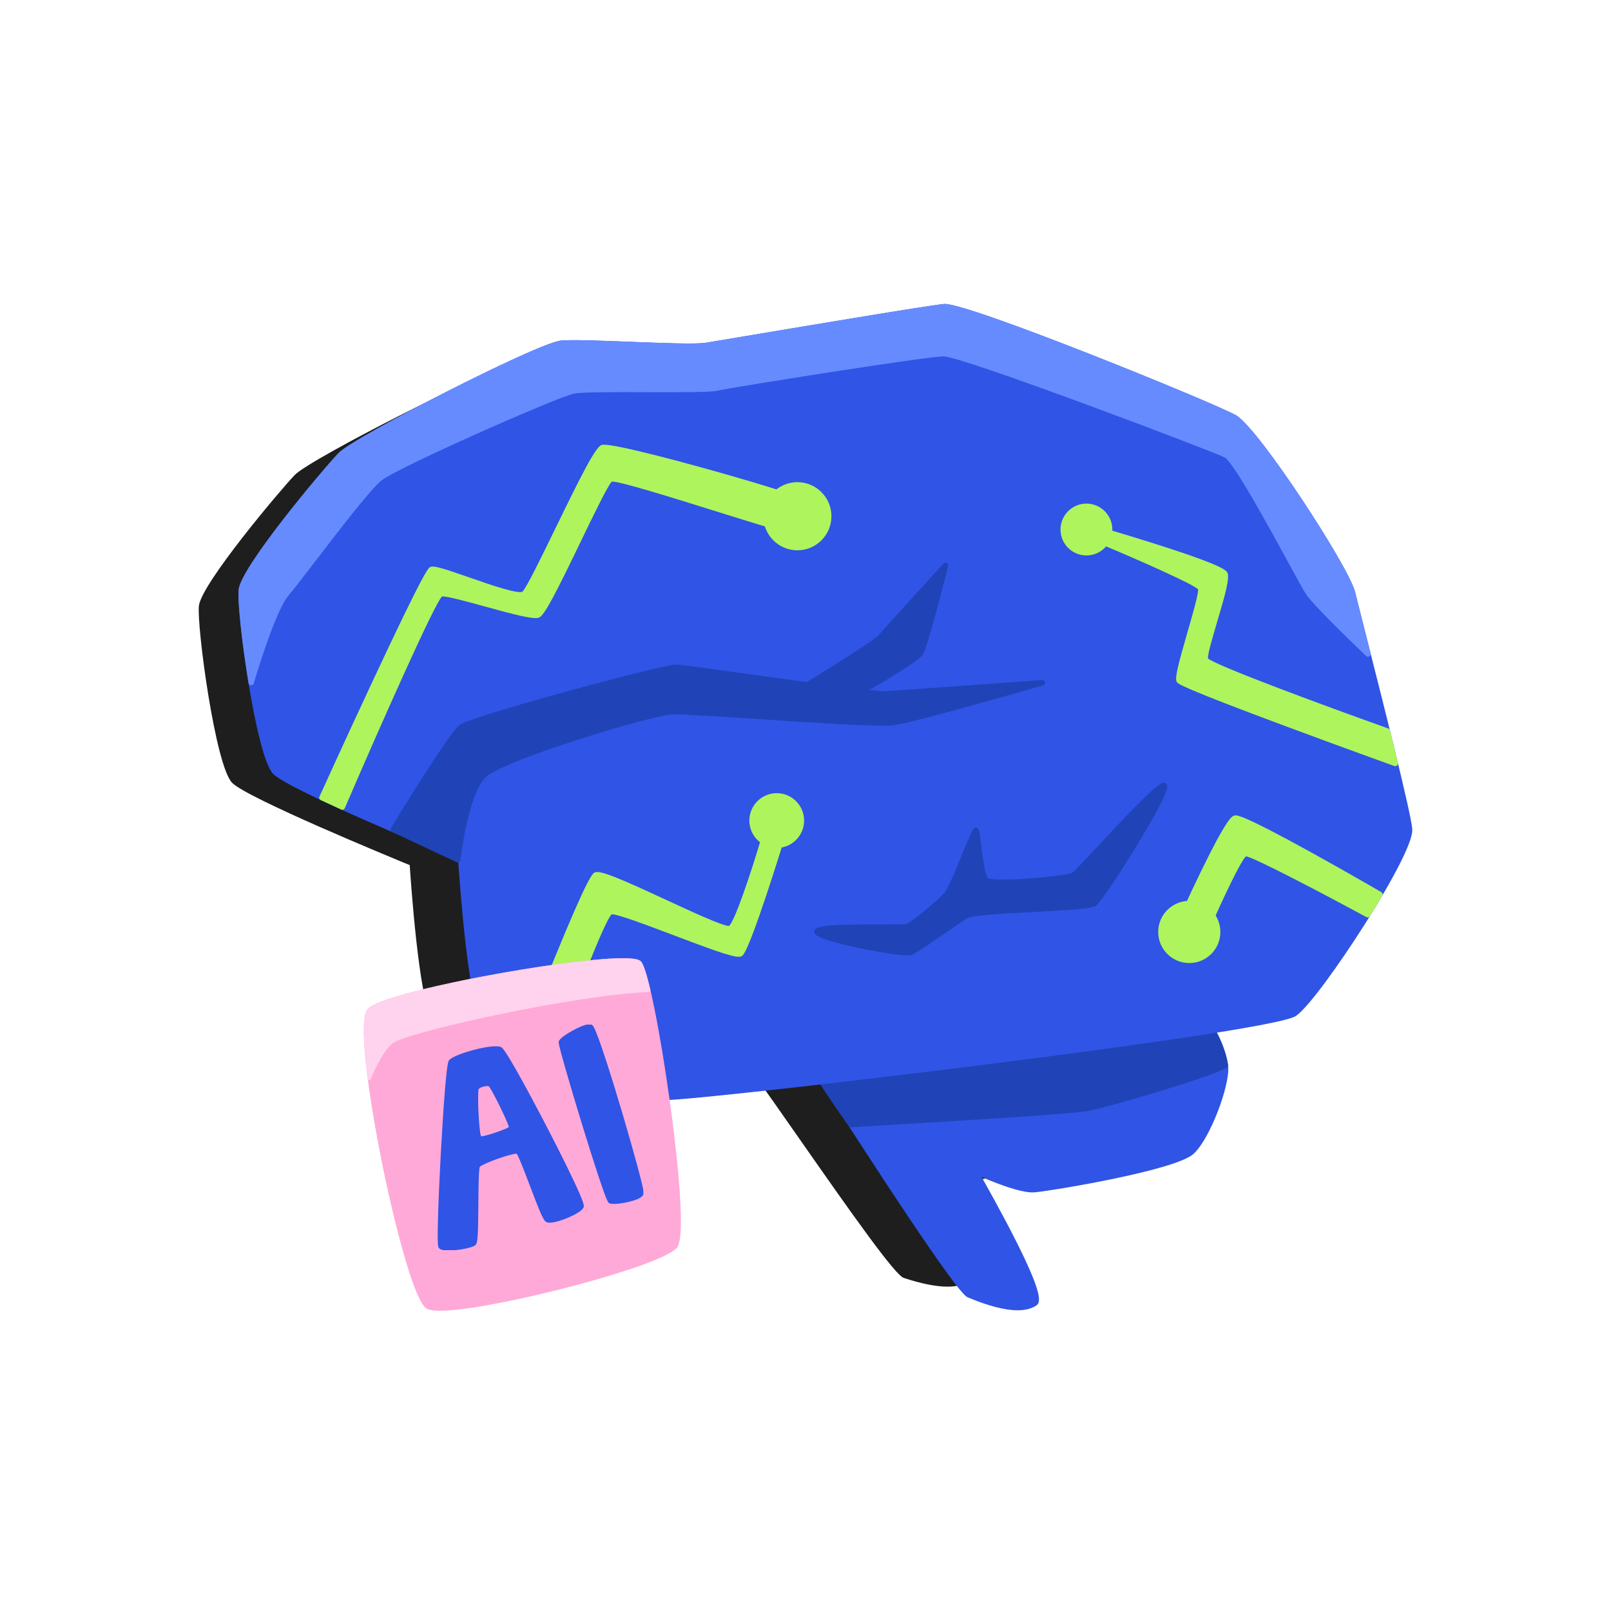
Natural Language Processing: Pre-processing’s Basics
Mina Farmanbar
Associate Professor, University of Stavanger
for engineers

Slide 2
Stop words and punctuation
@UiS and @IDE are developing a new AI course at https://www.uis.no/en/studies/artificial-intelligence-for-engineers-dat305!!!
and is are at has for the a
, : . ! ? “
Stop Words
Punctuations
@UiS @IDE developing new AI course https://www.uis.no/en/studies/artificial-intelligence-for-engineers-dat305

Slide 3
Stemming
Stemming is a process to reduce the words to their base or root form, known as the stem.
It involves removing suffixes or prefixes from the words to extract their base form, thus, reducing multiple variations of a word to a common form.
fish
tune
fish
fishing
tun
tuning
fishes
tuned

Slide 4
Lowercasing
To reduce your vocabulary even further without losing valuable information, you'd have to lowercase every one of your words.
Great
GREAT
great
great

Slide 5
Tokenization
Tokenization is the process of breaking down a piece of text, like a sentence or a paragraph, into individual words or “tokens.”
Sentence: “I love natural language processing”
Tokens: [“I”, “love”, “natural”, “language”, “processing”]
Whitespace Tokenizer

Slide 6
Tokenization
N-gram tokenizers segment the text into contiguous sequences of n tokens.
Sentence: “I love natural language processing”
Tokens: [“I love”, “love natural”, “natural language”, “language processing”]
Bigrams
Tokens: [“I love natural”, “love natural language”, “natural language processing”]
Trigrams

Slide 7
Part of Speech (POS)
POS tagging is a fundamental task in NLP that involves labeling each word in a sentence with its corresponding grammatical category or part of speech, such as noun, verb, adjective, adverb, and etc.
Sentence: “Tom likes to eat cake”
NN VB IN VB NN
Sentence: “Google something on the internet”
VB NN IN DT NN

Slide 8
Thank you!
Mina Farmanbar
mina.farmanbar@uis.no

